Slide 1



INTERNSHIP PROJECT ON
DATA ANALYTICS USING PYTHON & TABLEAU
Presented by
T. Akshitha - 160121771072
P. Kathyayini - 160121771088
A. Tejas - 160121771095

Slide 2
About the Company
Objectives
Workflow
Project Allotted
Implementation of the Project
Learnings
Challenges
AGENDA

Slide 3

About TwiLearn
TwiLearn EduTech Pvt Ltd is committed to providing accessible and affordable education to people across the globe. Their team consists of passionate educators and technology enthusiasts who are dedicated to revolutionizing the way people learn.

Slide 4
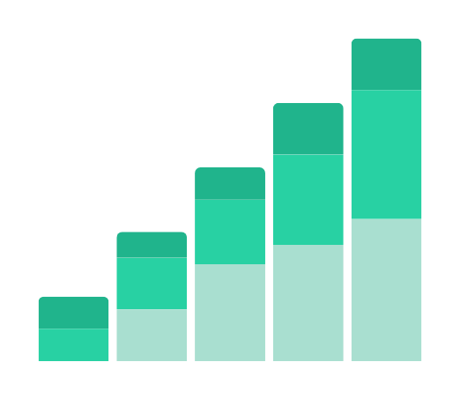


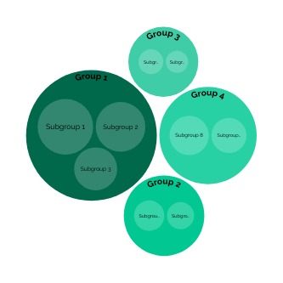
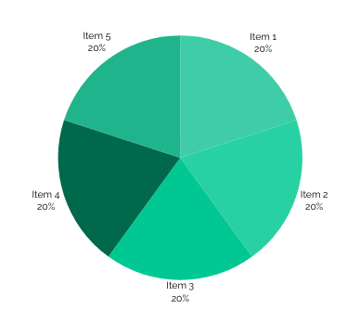

Objectives
Establish a strong foundation in Python programming language.
Equip interns with the skills to manipulate and analyze data efficiently.
Develop expertise in data cleaning and exploratory data analysis (EDA).
Gain a solid understanding of statistical concepts and their application in data analysis.
Develop proficiency in data visualization using Tableau.
Apply acquired skills to real-world projects.

Slide 5


Workflow
Week-01. Python Basics and
Week-04. Statistics and Applied
Data Structures
Statistics with Case Study
Week-02. Numpy and Pandas
Week-05. Tableau Basics and
for Data manipulation
Intermediate
Week-03. Data Cleaning and
Week-06. Tableau Dashboard
Exploratory Data Analysis
Creation with Case Study
Week-07 Project Work

Slide 6
Project-1
Heart Disease Diagnostic Analysis
Problem Statement
Health is real wealth & in the pandemic time we all realized the brutal effects of covid-19 on humanity. Using the provided health and medical data, we are required to draw important insights for better future preparation.
Do ETL: Extract- Transform and Load data from the heart disease diagnostic database, perform EDA through python. Extract various information such as Heart disease rates, Heart disease by gender, by age.
Compare attributes of the data set to extract necessary information.
Make the necessary dashboard with the best you can extract from the data. Use various visualizations and features to make the best dashboard
Find key metrics and factors and show the meaningful relationships between attributes.

Slide 7
Project-1
Heart Disease Diagnostic Analysis
Details of Dataset
Age
Sex
Chest pain type (4 values)
Resting blood pressure
Serum cholestoral in mg/dl
Fasting blood sugar > 120 mg/dl
Resting electrocardiographic results (values 0,1,2)
Maximum heart rate achieved
Exercise induced angina
Oldpeak = ST depression induced by exercise relative to rest
The slope of the peak exercise ST segment
Number of major vessels (0-3) colored by flourosopy
Thal: 0 = normal; 1 = fixed defect; 2 = reversable defect

Slide 8
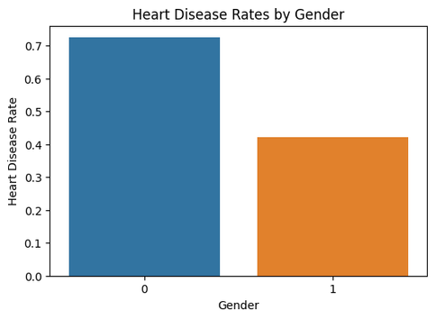
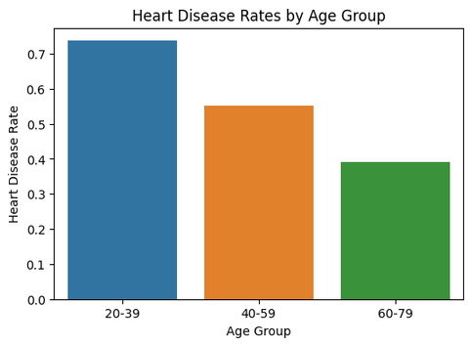
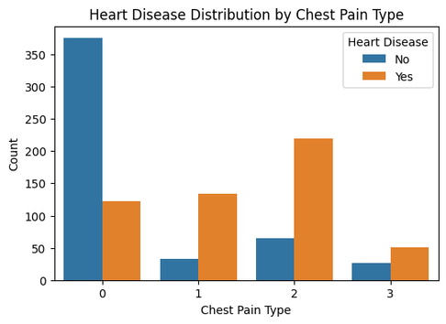
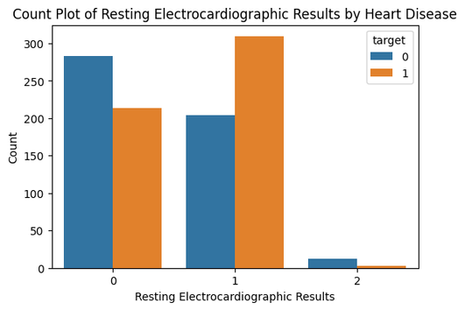
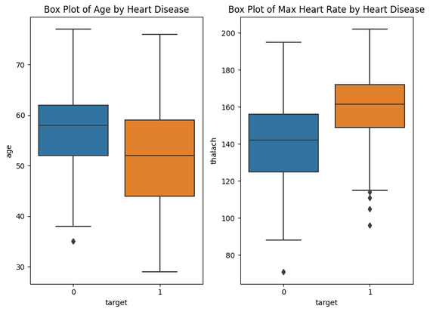
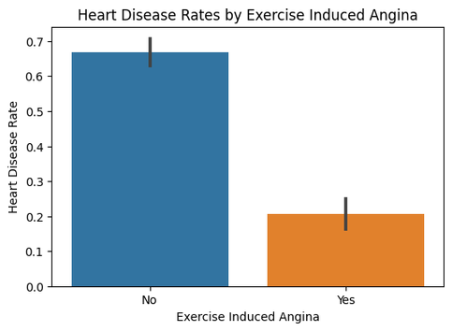
Project-1
Heart Disease Diagnostic Analysis

Slide 9
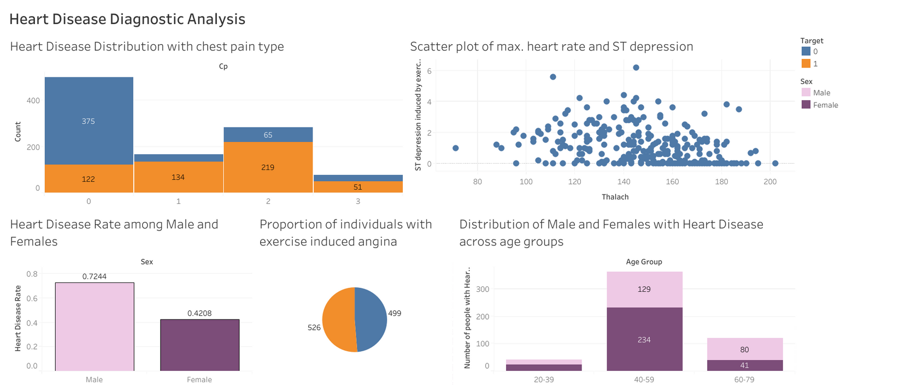
Project-1
Heart Disease Diagnostic Analysis
Tableau Dashboard

Slide 10
Project-2
Swiggy Bangalore Outlet Data Analysis
Problem Statement
The online food ordering market includes foods prepared by restaurants, prepared by independent people, and groceries being ordered online and then picked up or delivered.
Extract actionable insights from Swiggy data by exploring customer behavior, delivery patterns, and restaurant performance to make data-driven decisions to enhance business operations.
Do ETL: Extract-Transform-Load on the dataset and draw meaningful insights from the given data.
Compare attributes of the data set to extract necessary information.
Make the necessary dashboard with the best you can extract from the data. Use various visualizations and features to make the best dashboard
Find key metrics and factors and show the meaningful relationships between attributes.

Slide 11
Project-2
Swiggy Bangalore Outlet Data Analysis
Details of Dataset
Shop Name – Name of the restaurant/hotel
Cuisine – Name of the cuisione available in that restaurant
Location – Address of the shop/restaurant/hotel
Cost_for_two – Average cost to be paid by the customers eating food from that hotel
Rating – Rating of the hotel/restaurant

Slide 12
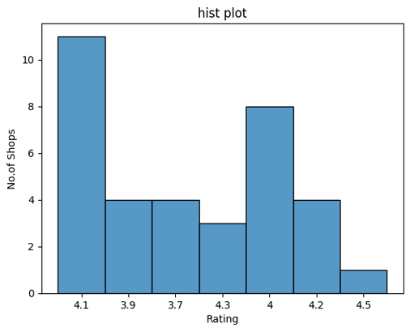
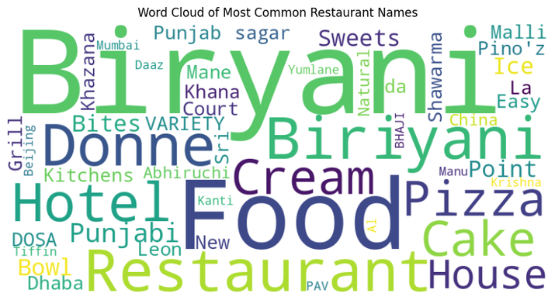
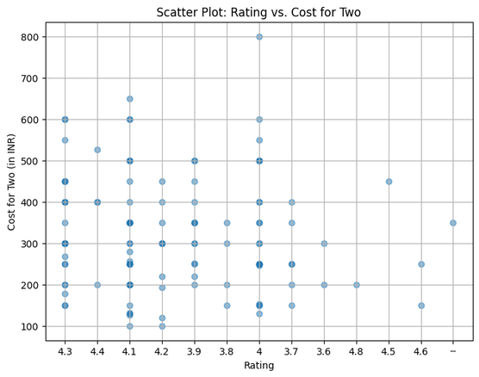
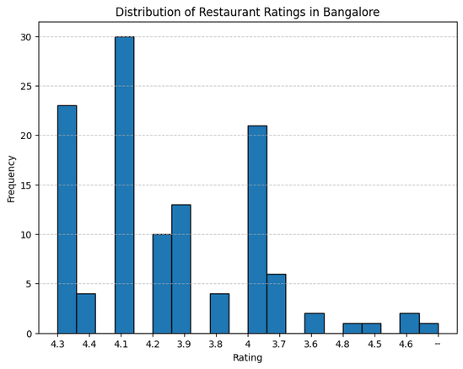
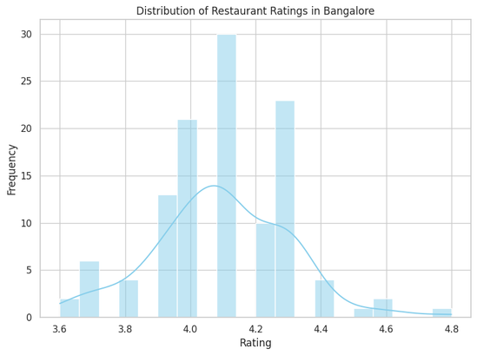
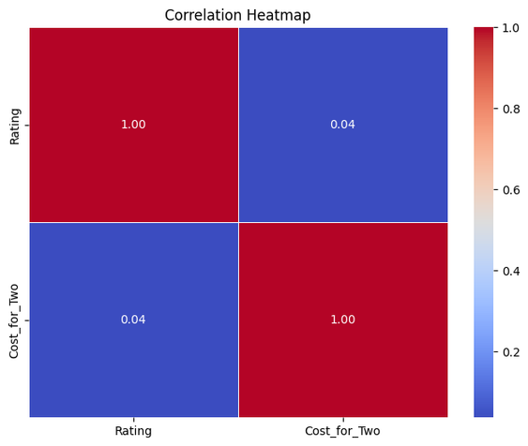
Project-2
Swiggy Bangalore Outlet Data Analysis

Slide 13
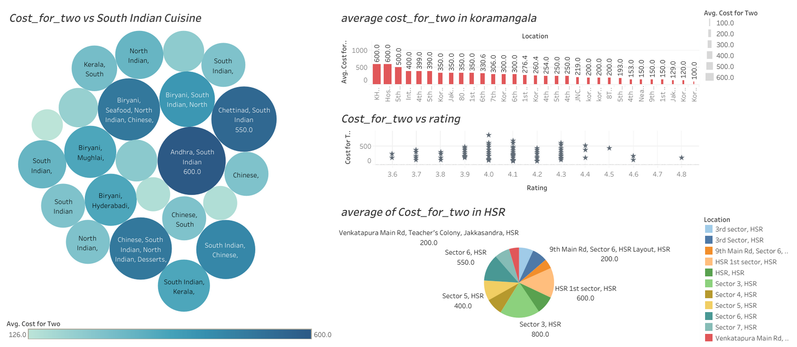
Project-2
Swiggy Bangalore Outlet Data Analysis
Tableau Dashboard

Slide 14
Learnings
Data Quality and Cleaning: Dealing with missing values, outliers, and inconsistencies in the dataset.
Data Integration: Integrating data from multiple sources with different formats or structures.
Complex Statistical Analysis: Conducting complex statistical analyses that require a deep understanding of statistical concepts.
Effective Visualization: Creating meaningful and insightful visualizations using Matplotlib and Seaborn.
Dashboard Design in Tableau: Designing a cohesive and user-friendly dashboard in Tableau that effectively communicates insights.

Slide 15
Challenges
Acquired proficiency in cleaning and handling real-world datasets.
Developed a strong foundation in statistical analysis, interpreting results, and applying advanced techniques for a deeper understanding of data patterns.
Mastered the creation of impactful visualizations using Matplotlib and Seaborn, selecting appropriate chart types to enhance data communication.
Gained expertise in seamlessly forming insightful dashboards with Tableau
Experienced end-to-end project management, emphasizing collaboration, effective communication, and adaptability

Slide 16


Thank you !

